Slide 1
R Workshop – Day 1
Randi L. Garcia
Smith College
July 17th, 19th, and 21st

Slide 2
Day 1
Installing R and RStudio
RStudio environment, packages, and R Markdown
Data cleaning
Making figures
Descriptive stats, correlations, reliability, t-tests

Slide 3
Day 2
ANOVA and regression
Preparing APA style manuscripts
Exploratory Factor Analysis (EFA) and Confirmatory Factor Analysis (CFA)
Path Analysis and SEM

Slide 4
Day 3
Multilevel Modeling
Growth Curve Modeling
Dyadic Data Analysis

Slide 5
Workshop Materials
>Find the workshop schedule and data examples here:
https://randilgarcia.github.io/smith-r-workshop/
>Download ALL materials, including R-code, here:
https://github.com/RandiLGarcia/smith-r-workshop

Slide 6
Installing R and RStudio
Click links on Website…
When we’re done I’ll take you on a tour of RStudio

Slide 7
Data Cleaning
The package we’ll use for data cleaning is called dplyr.
The Verbs
filter()
mutate()
rename()
arrange()
select()
summarize()
group_by()

Slide 8
Data Cleaning
Each verb performs familiar operations of a dataset
Verb | What is does | …in SPSS
mutate() | Creates new variables | COMPUTE (or transform in menu)
filter() | Filters for specific cases | FILTER (or select data in menu)
arrange() | Sorts using some logic | SORT
select() | Subsets for only certain variables | DROP
group_by() | Groups dataset by a categorical variable | Like split file in menu
summarize() | Create a summary table | Descriptive statistics

Slide 9
Data Cleaning
We will use the pipe operator to combine verbs!
The pipe:
%>%
filter(dataset, age >= 18)
…is the same as:
dataset %>% filter(age >= 18)

Slide 10
Data Cleaning
Why the pipe!?!?
Instead of reading/writing:
select(filter(mutate(dataset, bdi = bdi1 + bdi2 + bdi3), age >= 18) bdi, soc_sprt)
We can write:
dataset %>%
mutate(bdi = bdi1 + bdi2 + bdi3) %>%
filter(age >= 18) %>%
select(bdi, soc_sprt)

Slide 11
Data Cleaning
If you wanted to save this two-variable dataset:
dataset_small <- dataset %>%
mutate(bdi = bdi1 + bdi2 + bdi3) %>%
filter(age >= 18) %>%
select(bdi, soc_sprt)

Slide 12
Data Cleaning
There are also verbs for joining two tables
Adding cases from another dataset that has the same variables
And also when they do not have exactly the same variables
Adding variables from another dataset
These variables can be measured at the same level or at a higher level, as long as there are index variables.
And verbs for transforming data from
Wide-to-long
Long-to-wide
We can learn these on Day 3 if you want…?

Slide 13
R Markdown File

Slide 14
Making Figures with ggplot2
As with everything else, there are lots of ways to make figures in R
Base R
Lattice graphics
The ggplot2 package
We’ll be learning the ggplot2 package.
It makes beautiful visualizations
It’s popular so there is a lot of help on the internet and companion code
Written by the same person who wrote dplyr and it works at the end of a pipeline
It is what Smith students know how to use

Slide 15
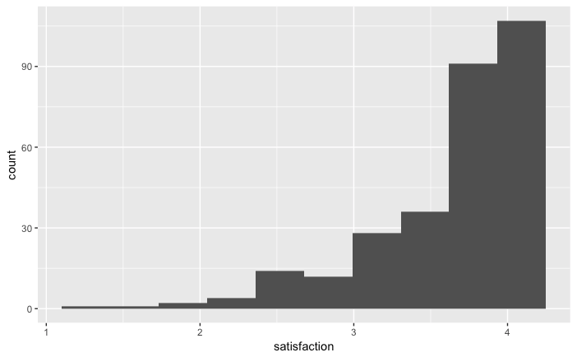
Making Figures with ggplot2
The easiest figures are made with the qplot() function
qplot(satisfaction, data = acitelli, bins = 10)

Slide 16
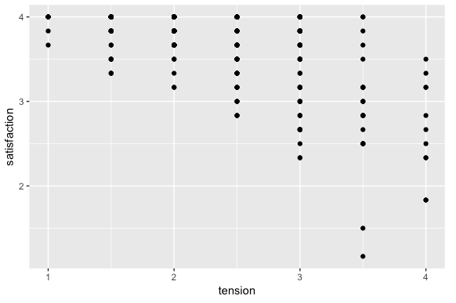
Making Figures with ggplot2
qplot(x = tension, y = satisfaction, data = acitelli)

Slide 17
Making Figures with ggplot2
The qplot() function is good for quick visualizations
Good for probably 80% of what you’d want to do while analyzing data
But, you’ll use the ggplot() function for anything more involved, probably for making figures for publication
The ggplot2 packages uses the “grammar of graphics"

Slide 18
Making Figures with ggplot2
We independently specify pieces of the graph using the “grammar of graphics”
Building blocks:
Data
Geometric objects (the actual things we’ll draw: points, lines, boxplot, histograms, etc.)
Aesthetic mappings (what and where we’ll draw: x-axis, y-axis, color, fill, shape, size, linetype, etc.)
Statistics (implied or specified computing to be done)
Scales (range of values, colors, or shapes)
Facets (the panes—there can be more than 1, layers in SPSS)
Guides (legends—what the humans see)

Slide 19

ggplot()

Slide 20
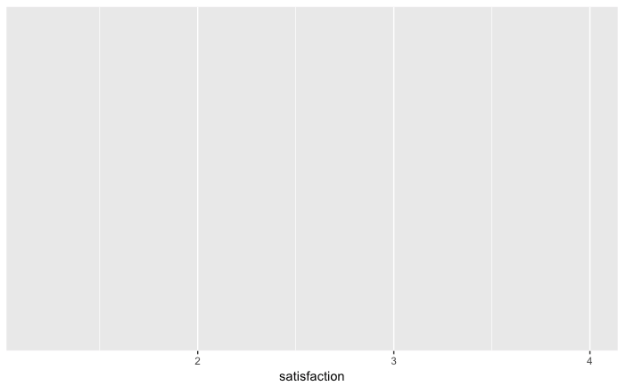
ggplot(acitelli, aes(x = satisfaction))

Slide 21
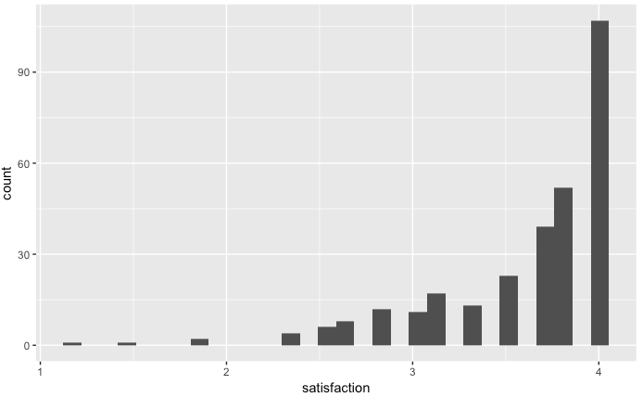
ggplot(acitelli, aes(x = satisfaction)) + geom_histogram()
Statistic
Geometric object

Slide 22
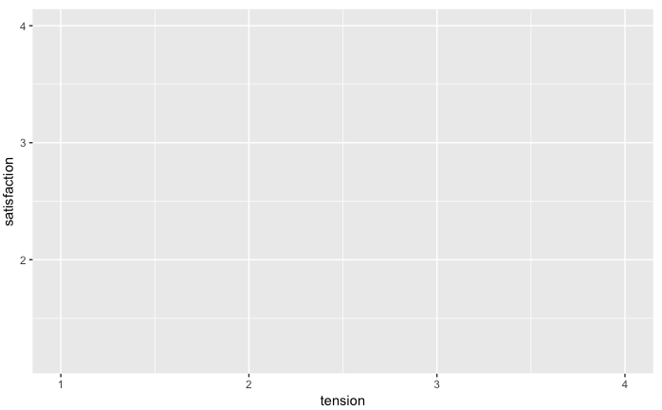
ggplot(acitelli, aes(x = tension, y = satisfaction))

Slide 23
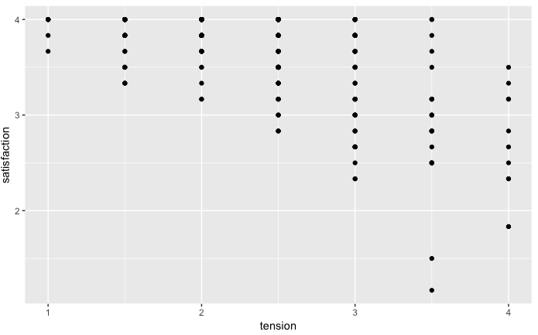
ggplot(acitelli, aes(x = tension, y = satisfaction)) + geom_point()

Slide 24
R Markdown File

Slide 25
Correlation Matrices, Reliability, and t-Tests
For correlation matrices and Cronbach’s alpha we’ll use the package called psych
For t-Tests I recommend you use mosaic because it has that (now familiar) formula, then data, syntax

Slide 26
Correlation Matrices, Reliability, and t-Tests
Correlation Matrix
corr.test()
I like to use this with select():
corr.test(select(acitelli, tension, self_pos, other_pos, satisfaction))
Reliability
alpha()
Also handy with select:
alpha(select(acitelli, sat1, sat2, sat3, sat4, sat5, sat6))
vars for matrix
items for alpha

Slide 27
Correlation Matrices, Reliability, and t-Tests
Independent samples and paired samples t-tests
t.test(satisfaction ~ Gender, data = acitelli)
t.test(self_pos, other_pos, data = acitelli, paired = TRUE)

